Slide 1
EDUCATION & LEARNING MANAGEMENT SYSTEM
​Empowering Education through Technology
SHAIK NAGUL MEERA
DEVI PRASANNA TAMARAKOLANU

Slide 2
COAPPS PYTHON FULLSTACK DEVELOPER INTERNSHIP
Collaborative Online Application Platform and Programming Skills. COAPPS is a collaborative online application platform designed to provide hands-on experience and skills development for aspiring Python Fullstack Developers.
The internship program aims to offer practical training and mentorship in full-stack development using Python-based technologies.
COAPPS Python Fullstack Developer Internship offers practical training in full-stack development using Python.
Structured curriculum with hands-on projects and mentorship.
Benefits include practical experience, mentorship, and portfolio-building opportunities.

Slide 3
INTRODUCTION
Learning Management Systems (LMS) have become indispensable tools in modern education, revolutionizing the way we learn and teach. As technology continues to advance, the importance of LMS in facilitating flexible, interactive, and personalized learning experiences cannot be overstated.
Purpose of the Presentation:
To introduce our Learning Management System project developed using Python Fullstack.
To showcase the features and functionality of the system.
To demonstrate how Python Fullstack development can empower education through technology.

Slide 4
OBJECTIVES OF THE PROJECT
Enhancing Access to Education: By providing an online platform, we aim to make education more accessible to individuals regardless of their geographical location or time constraints.
Improving Learning Experience: We strive to create a dynamic and engaging learning environment by incorporating interactive elements such as quizzes, discussions, and multimedia content.
Streamlining Course Management: Our goal is to simplify administrative tasks for educators by offering tools for course creation, enrollment management, content delivery, and progress tracking.

Slide 5
THE E-LEARNING REVOLUTION
E-learning is rapidly transforming the educational landscape, providing flexible and accessible learning opportunities for a wider audience.
The global e-learning market is experiencing phenomenal growth, with projections estimating it to reach a staggering $398.15 billion by 2027.
This exponential growth is fueled by several factors, including the increasing demand for upskilling and continuous learning, the growing need for remote learning solutions, and the undeniable convenience and flexibility offered by online learning platforms.

Slide 6

WHY PYTHON SHINES FOR BUILDING AN LMS
Python's readability and clear syntax make it an ideal choice for beginners and experienced developers alike, promoting rapid development cycles.
Its vast and ever-expanding ecosystem of libraries provides developers with a treasure trove of powerful tools for web development, data analysis, and content creation.
Frameworks like Django and Flask offer robust structures and functionalities that serve as a solid foundation for building complex web applications, including feature-rich LMS platforms.
Python's cross-platform compatibility ensures that the LMS you develop functions seamlessly across different operating systems, providing a smooth learning experience for users on various devices.

Slide 7
TARGET AUDIENCE
Our Education & Learning Management System is tailored to meet the needs of various stakeholders, including:
Students: Individuals seeking to expand their knowledge and skills through online courses.
Educators: Instructors looking to deliver educational content in a flexible and interactive manner.
Administrators: Academic institutions or organizations responsible for managing course offerings, user accounts, and overall system administration.
KEY POINTS TO EMPHASIZE
Clear understanding of the project's purpose and goals.
Consideration of the needs and preferences of the target audience.
Alignment of project objectives with the overarching goals of education and learning facilitation.

Slide 8
TECHNOLOGIES USED
Our Education & Learning Management System project harnesses a robust stack of technologies to ensure a seamless and efficient development process:
Python: Primary backend language for its simplicity and extensive libraries.
Django Framework: Powering our web development with its rapid development features and security.
HTML, CSS, JavaScript: Crafting the frontend for intuitive user experiences.
Bootstrap: Ensuring responsive design and cross-device compatibility.
RESTful API: Facilitating smooth communication between frontend and backend.
SQLite/PostgreSQL: Managing our database needs for data integrity and scalability.
Git: Enabling version control and collaboration among team members.
Docker: Streamlining deployment with containerization.

Slide 9
ARCHITECTURE
Client-Server Model:
Utilizes a client-server architecture where clients (web browsers) interact with the server hosting the application.
Clients make requests to the server for accessing courses, submitting assignments, and interacting with course materials.
Backend Structure:
Built using the Django framework, the backend consists of models, views, and controllers.
Django models define the structure of our database, representing entities such as users, courses, modules, and assignments.
Views handle incoming requests, process data from the models, and return appropriate responses.
Controllers contain the business logic, orchestrating the flow of data between models and views.
Frontend Structure:
HTML templates are used to generate dynamic web pages, providing the layout and structure of the user interface.
CSS stylesheets are applied to customize the appearance of the frontend, ensuring a visually appealing experience.
JavaScript scripts add interactivity to the frontend, allowing for dynamic content updates and user interactions.

Slide 10
Data Flow:
User interactions with the frontend trigger HTTP requests, which are routed to the appropriate views in the backend.
Views retrieve and manipulate data from the database using Django models.
Processed data is then rendered into HTML templates and returned as HTTP responses to the client.
Scalability and Performance:
Our architecture is designed to scale horizontally to accommodate increasing user traffic and data volume.
Utilizes caching mechanisms, asynchronous processing, and load balancing techniques to ensure optimal performance and responsiveness.

Slide 11
CORE FEATURES OF AN EFFECTIVE LMS
User Management: A robust system for creating and managing user accounts for various user groups, including students, instructors, and administrators. This ensures secure access and personalized learning experiences.
Course Management: Streamlined tools for creating, organizing, and delivering engaging course content in various formats, catering to diverse learning styles. This includes lectures, quizzes, assignments, interactive elements, and downloadable resources.
Content Delivery: A versatile platform for presenting learning materials in a variety of formats, such as text, video lectures, interactive simulations, downloadable resources, and collaborative activities. This caters to diverse learning styles and preferences.

Slide 12
Assessment Tools: Comprehensive features for creating quizzes, tests, assignments, and other forms of assessments to evaluate student learning, identify areas for improvement, and provide valuable feedback.
Progress Tracking: A system for monitoring student progress, completion rates, and performance data. This empowers instructors to personalize learning experiences, identify struggling students, and offer targeted support.

Slide 14
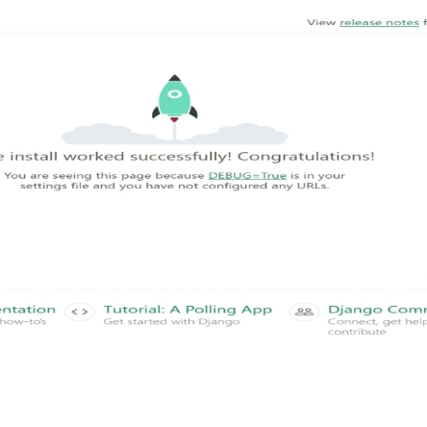
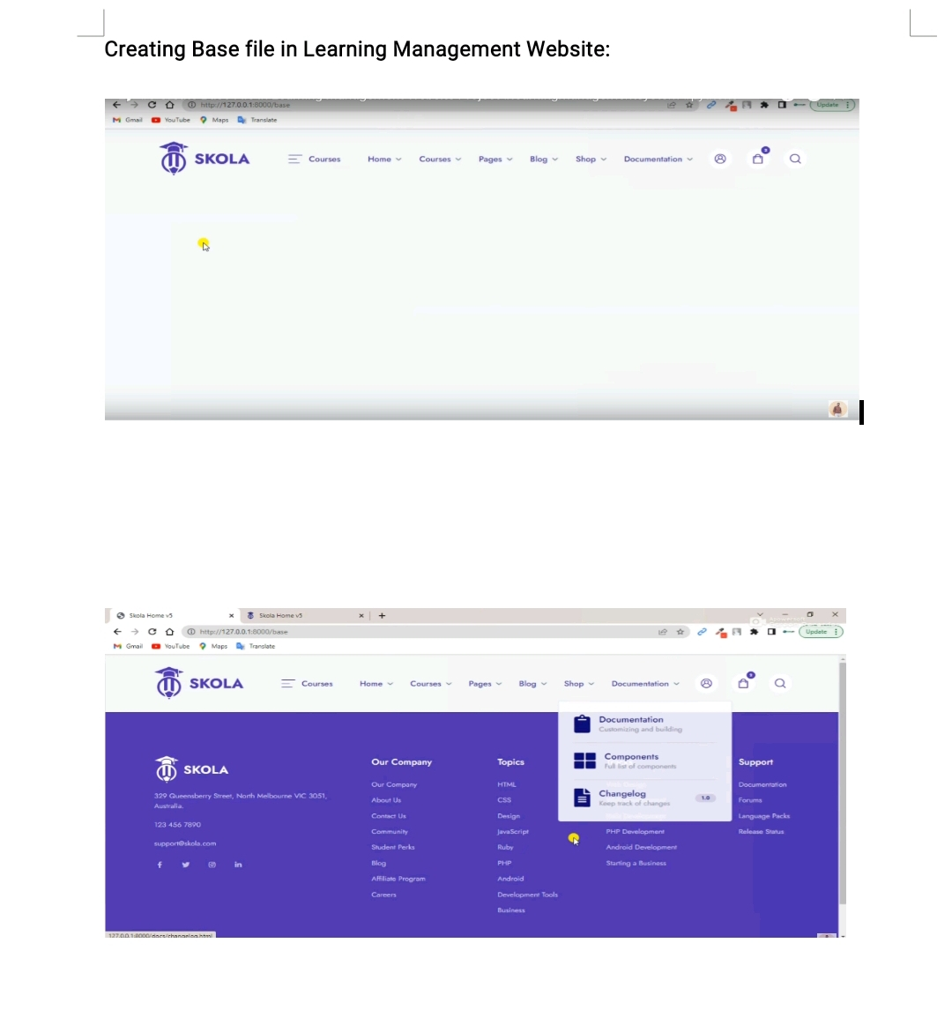
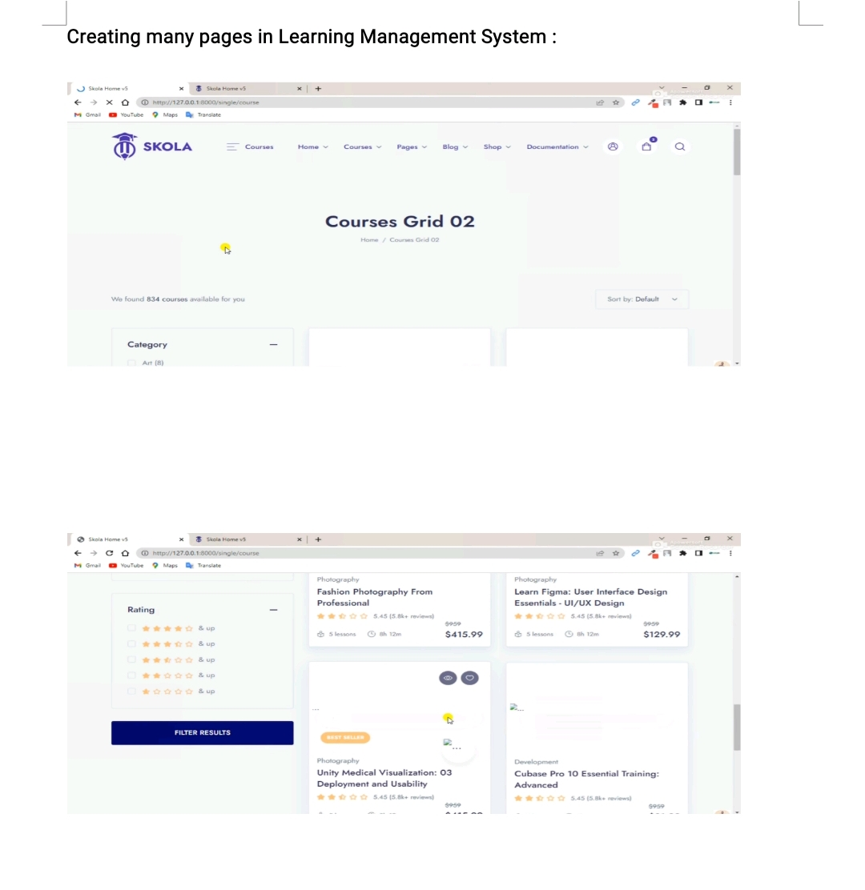
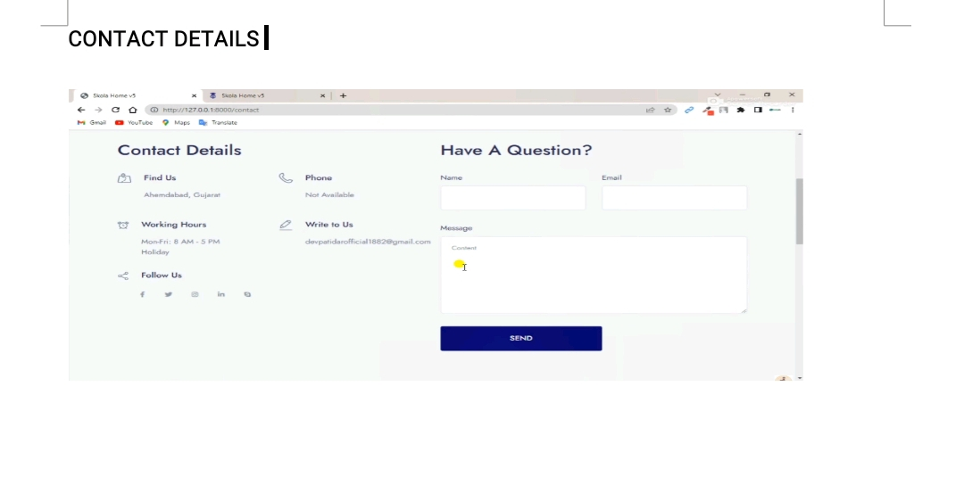
LMS
Django

Slide 15
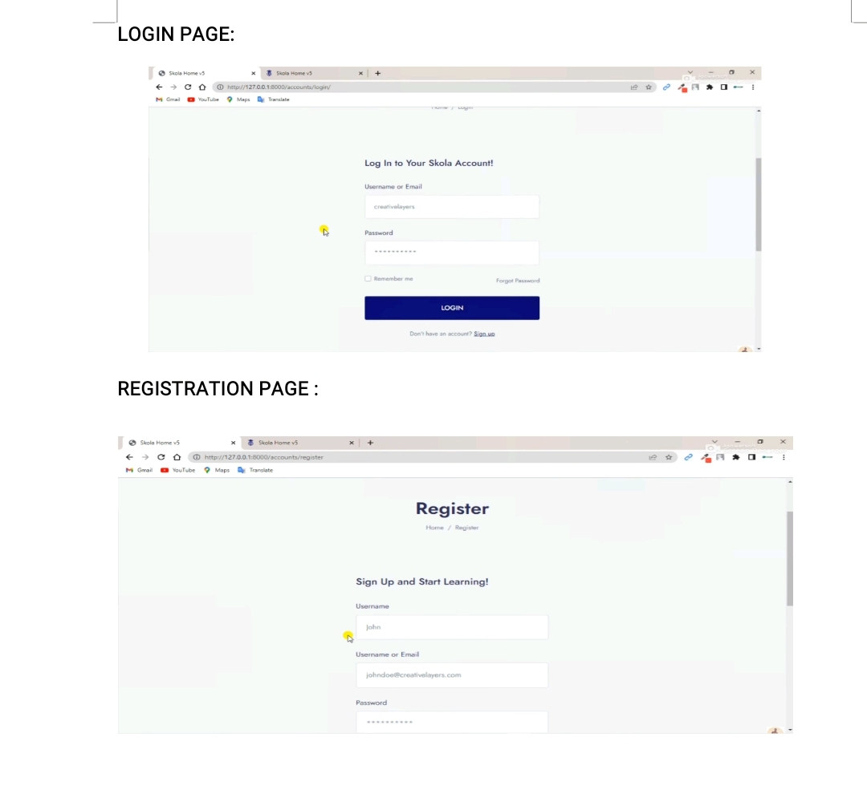
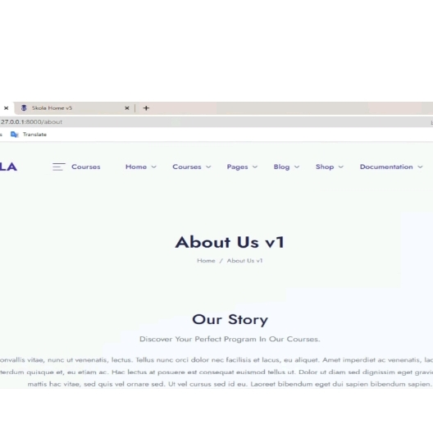
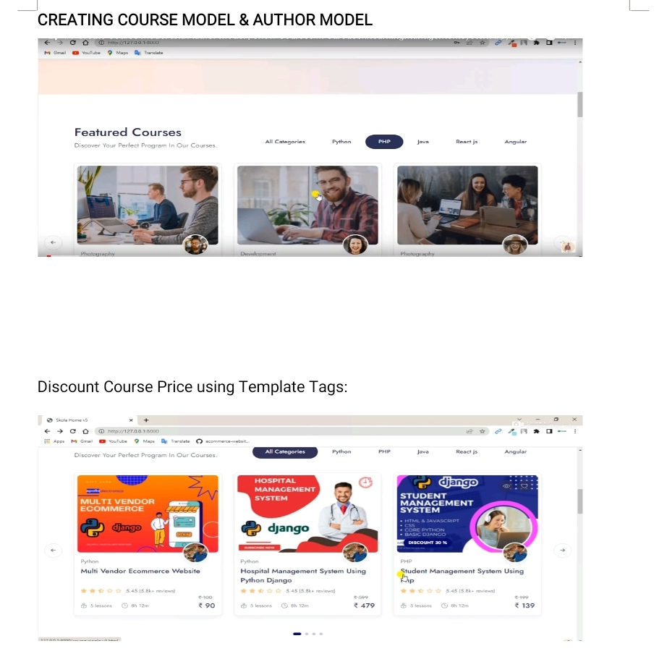
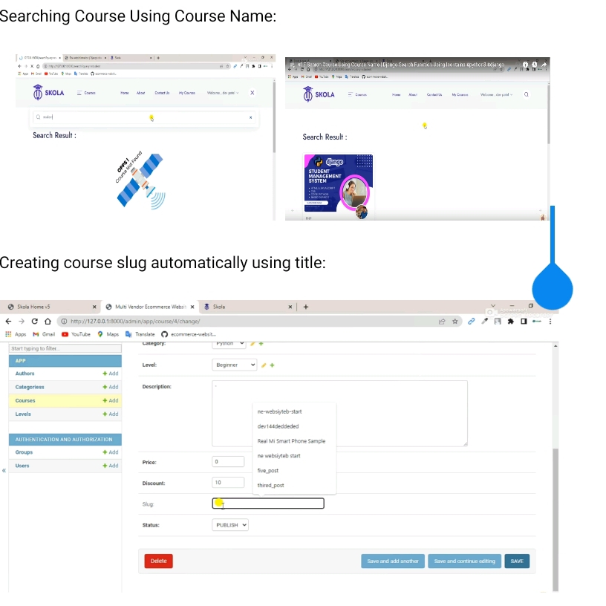

Slide 16
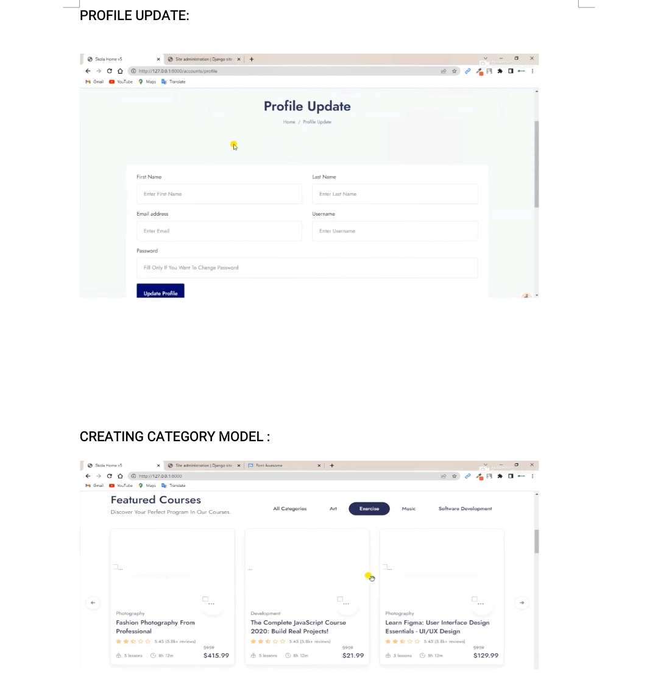
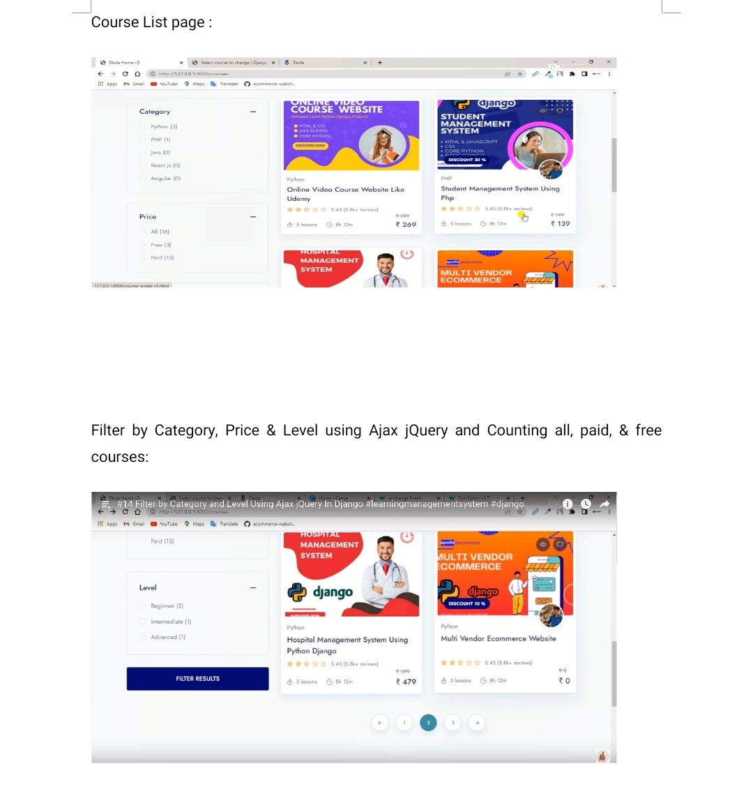
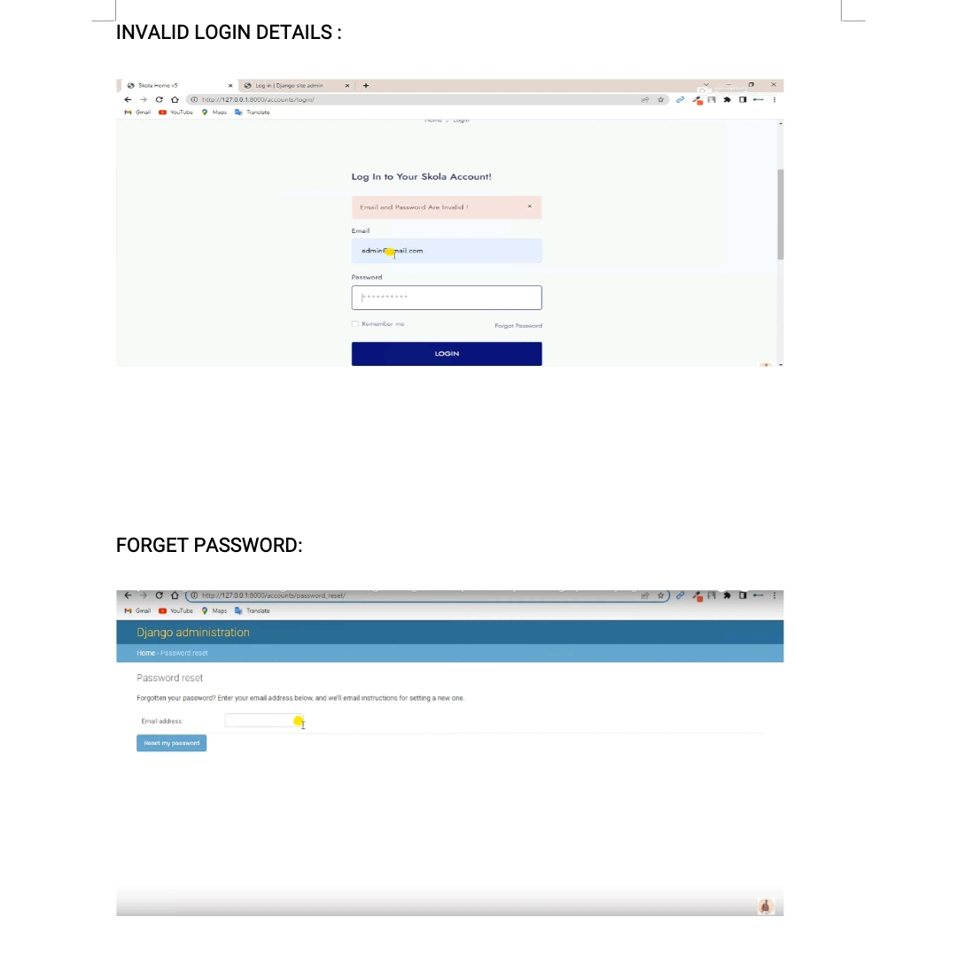
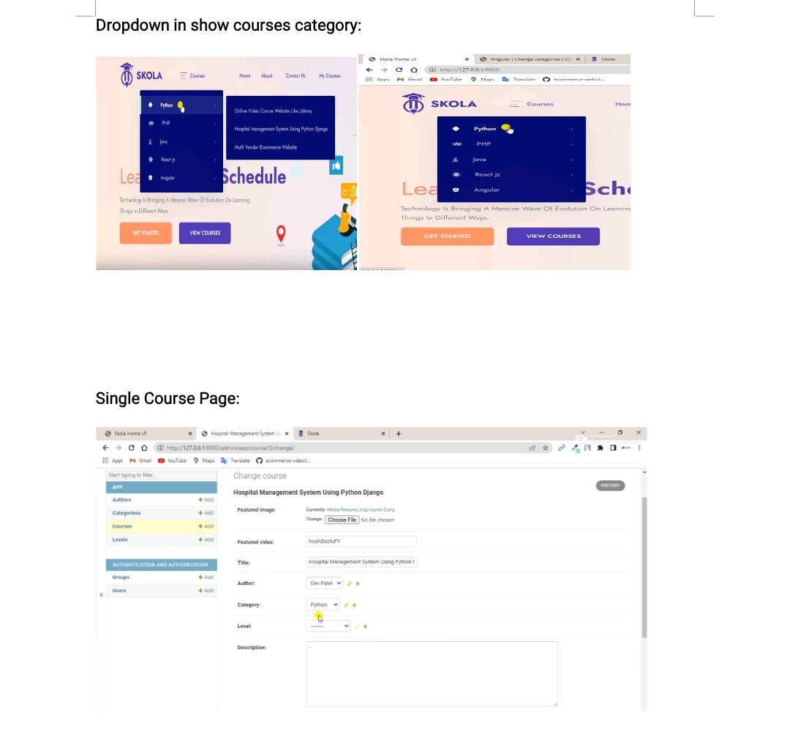

Slide 17
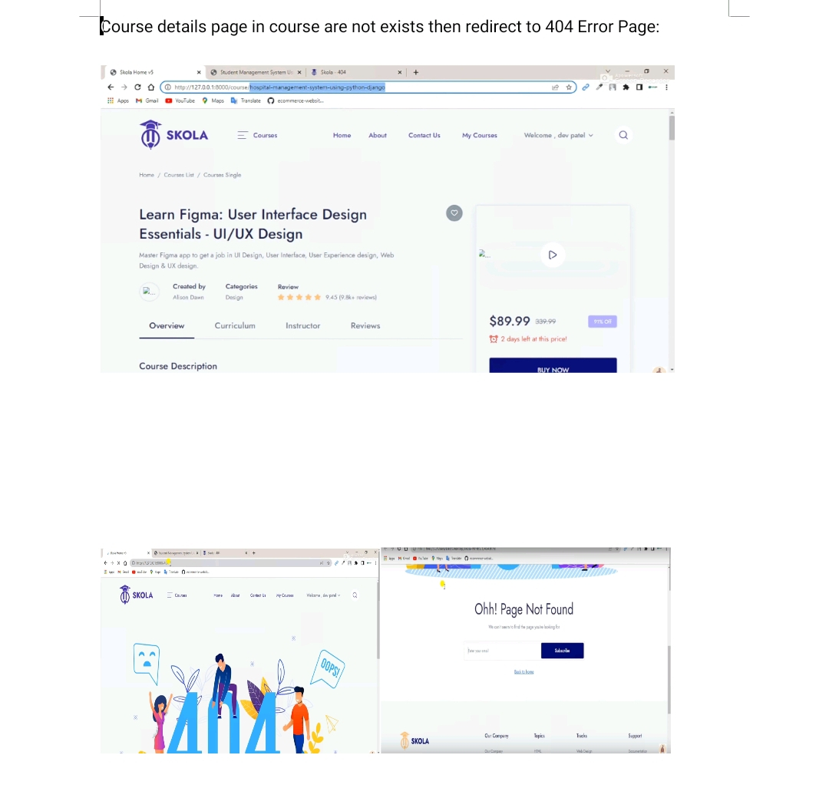
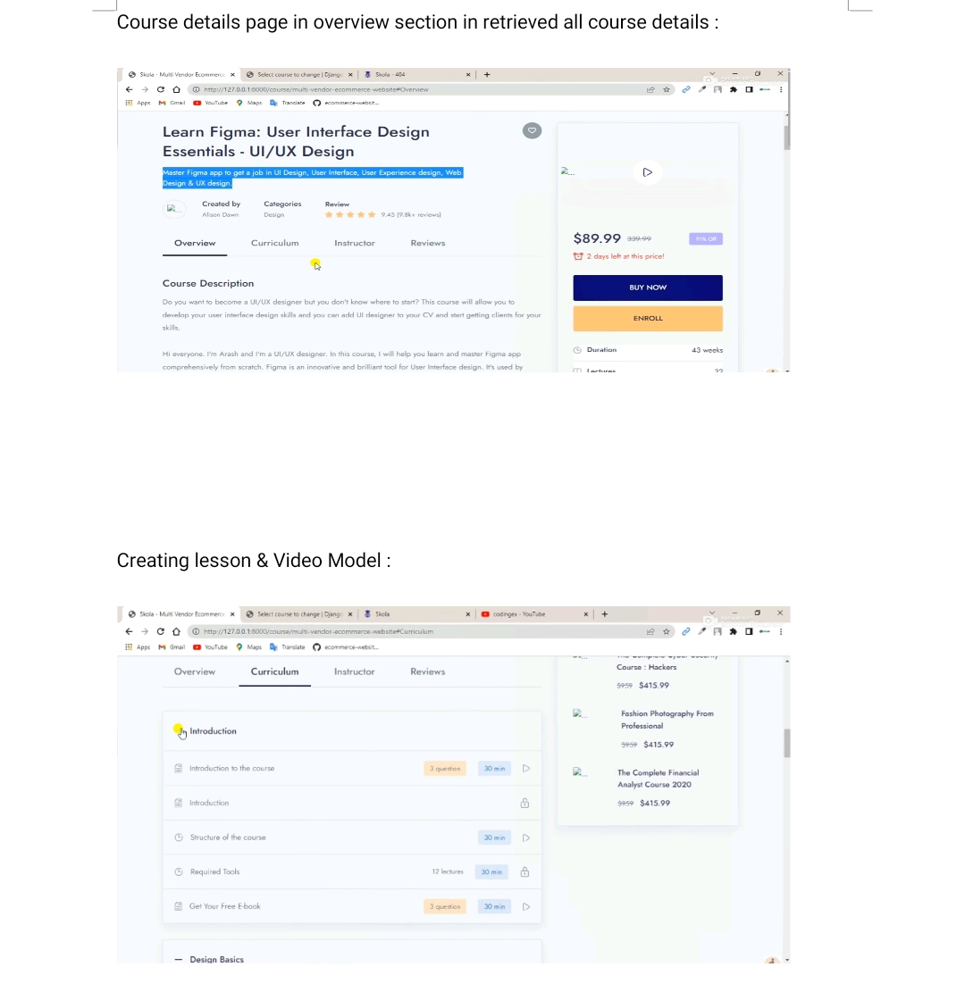
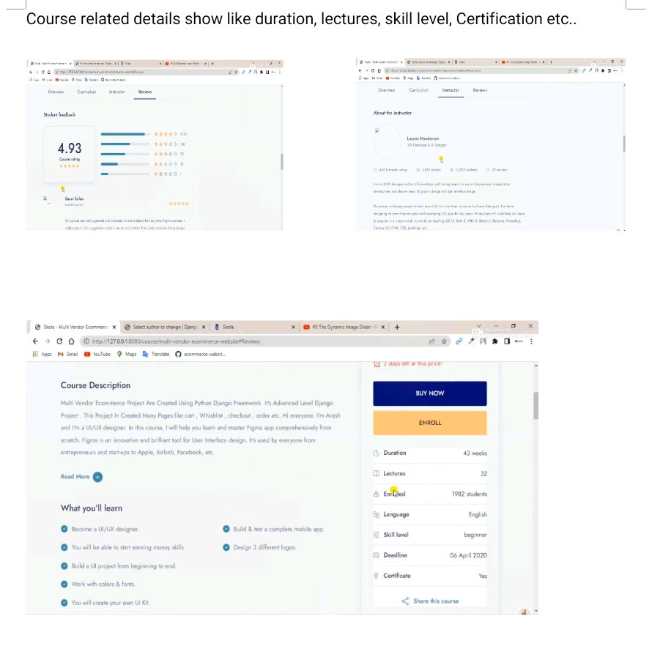
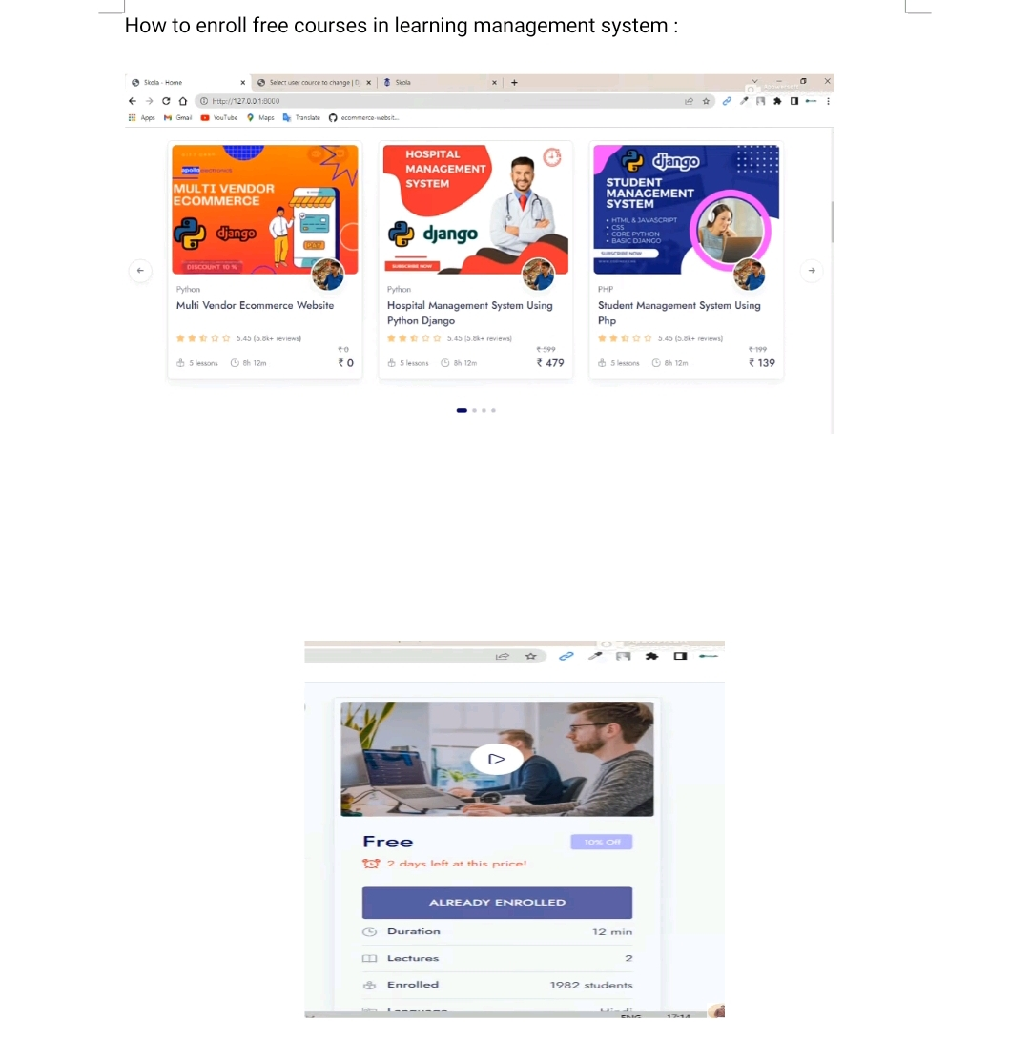

Slide 18
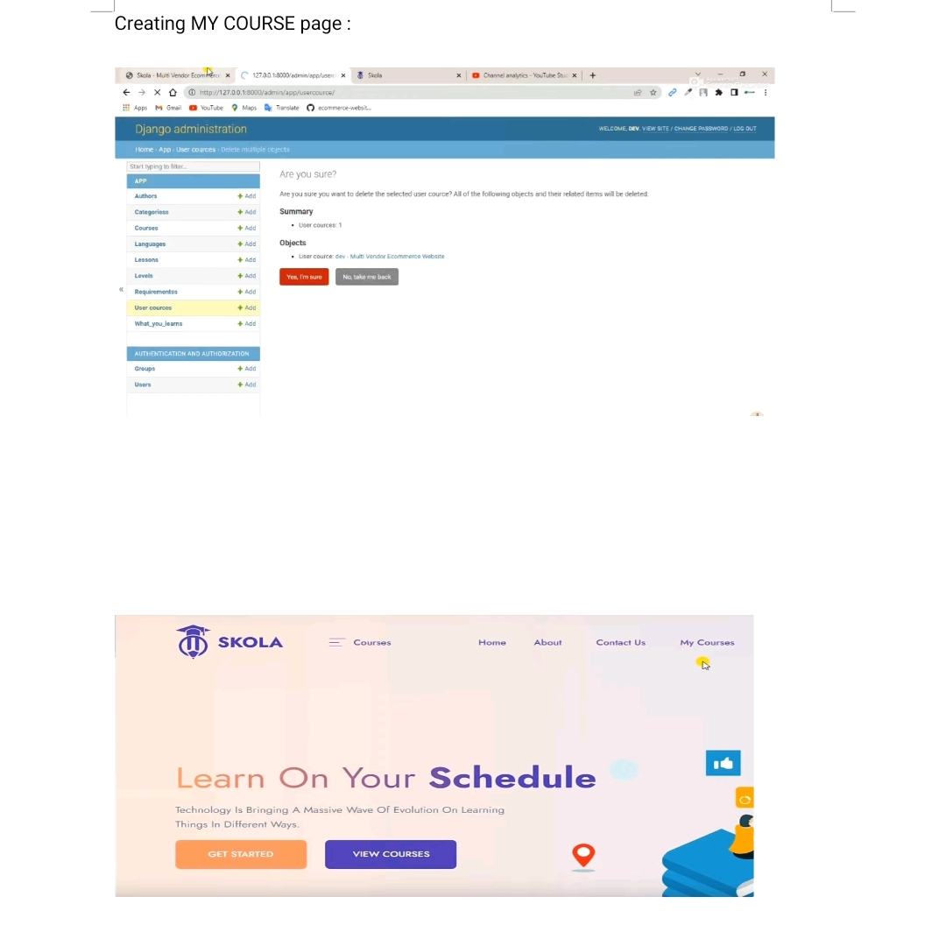
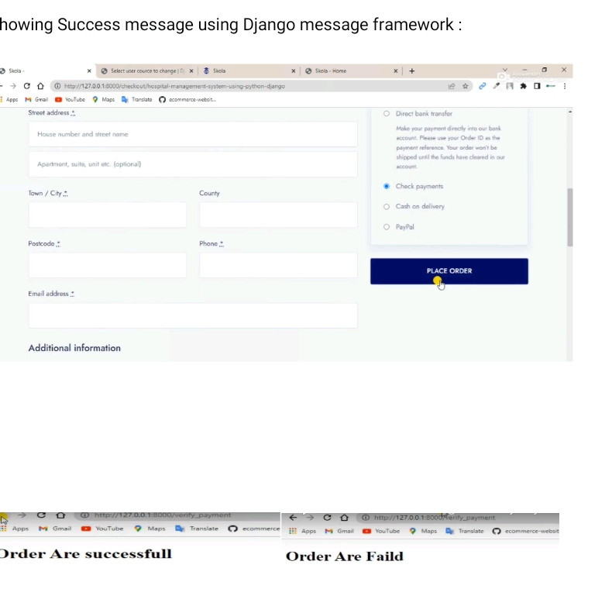
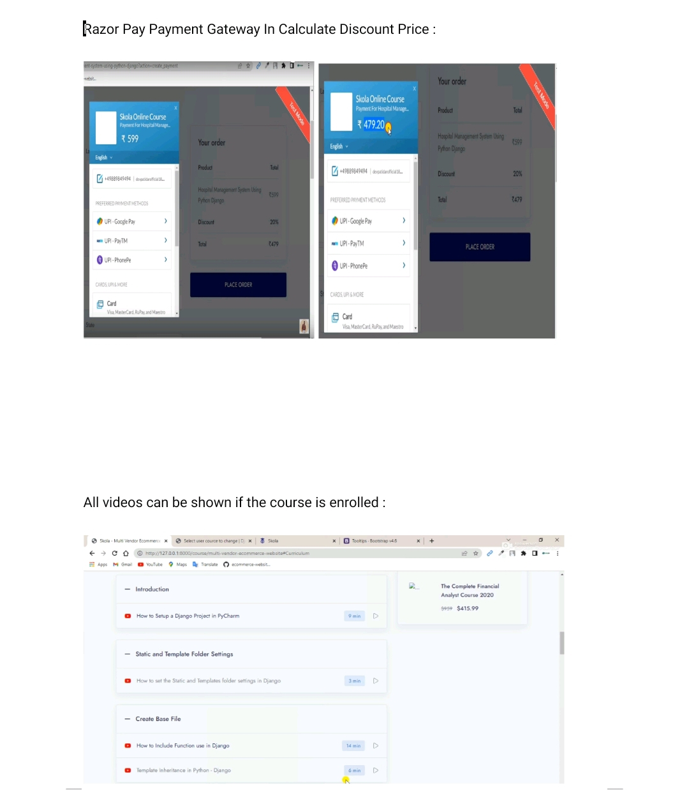
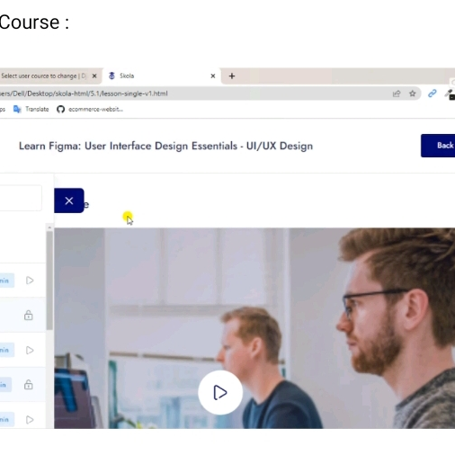

Slide 19
CONCLUSION
Our Education & Learning Management System project, developed using Python Fullstack, underscores the transformative potential of technology in education. By leveraging Python's versatility and Django's robustness, we've created a platform that empowers students and educators alike. As we move forward, we remain committed to innovation, with a focus on enhancing accessibility, interactivity, and efficiency in education. We extend our sincere thanks to all stakeholders, team members, and mentors for their invaluable contributions. Together, we're shaping the future of education through technology.

Slide 20
Thank you
SHAIK NAGUL MEERA
nagulmeerameera3934@gmail.com
DEVI PRASANNA TAMARAKOLANU
tdprasanna99@gmail.com

